Slide 1

WALMART RETAIL DASHBOARD AND ANALYSIS
A.LOKESH

Slide 2
INTRODUCTION
This dashboard provides a comprehensive view of Walmart's sales performance across key business areas, helping drive data-driven decision-making and strategic insights. The dashboard is organized into four main pages
Executive DashBoard
Product Analysis
Geographic Analysis
Customer Analysis

Slide 3
DATA OVERVIEW
CUSTOMER DEMOGRAPHICS
1 .Customer Name
2. Customer Age
3. Customer Segment
4. City
5. State
6. Zip Code
7. Age Category
PRODUCT INFORMATION
1. Product Name
2. Product Category
3. Product Sub Category
4. Product Container
ORDER INFORMATION
1. Order Id
2. Order Priority
3. Shipping Date
4. Shipping Mode
METRICS
1. Unit Price
2. Product Base Margin
3. Discounts
4. Profit
5. Order Quantity
6. Shipping Cost
7. Sales

Slide 4
DATA PROCESSING
Date collected from Data.world which has 1m records in the from of csv
Imported the csv file into python notebook for data cleaning such as removing null values, unwanted rows and duplicates
Uploaded the csv file into Power bi using MySQL database driver for dashboard and visualization
Imported consistent data into MySQL database for data transformation by removing unwanted columns and adding new columns

Slide 5
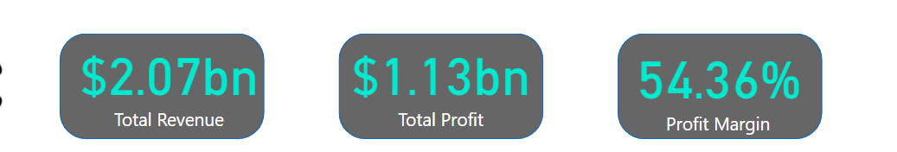
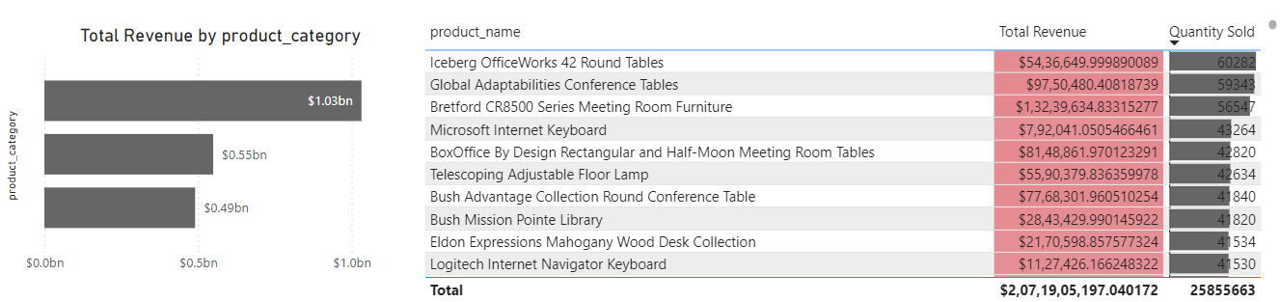
KEY METRICS

Slide 6
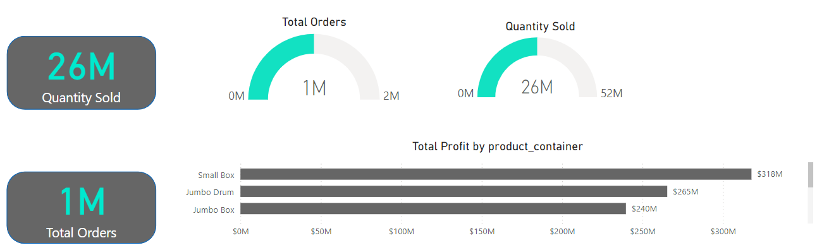
KEY METRICS

Slide 7
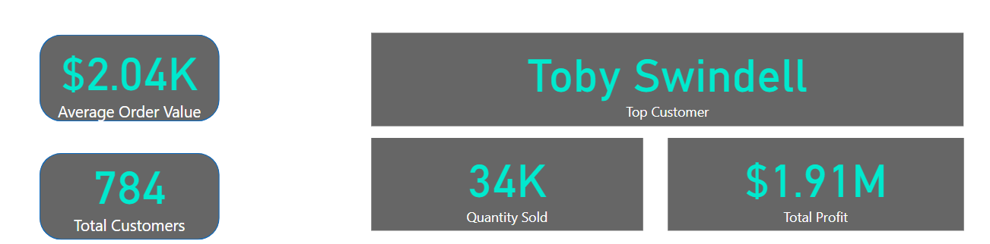
KEY METRICS

Slide 8
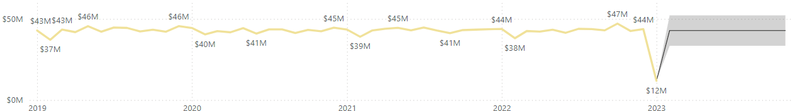
INSIGHTS AND ANALYSIS
Highest Sales were collected in October 2022 and lowest sales collected in January 2023
Revenue is dropping from January to February every year and is increasing with great margin from February to March

Slide 9
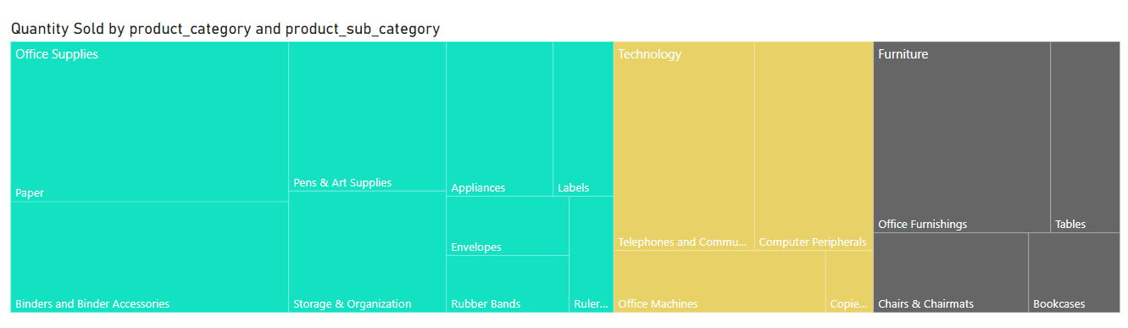
INSIGHTS AND ANALYSIS
For Highest sales contribution Paper contributed more for Office Suppliers, Telephones and Communication contributed more for Technology and Office Furnishings contributed more for Furniture
Similarly for low sales contribution Rulers and Trimmer contributed less for Office Supplies, Copies and Fax contributed less for Technology and Bookcases for Furniture

Slide 10
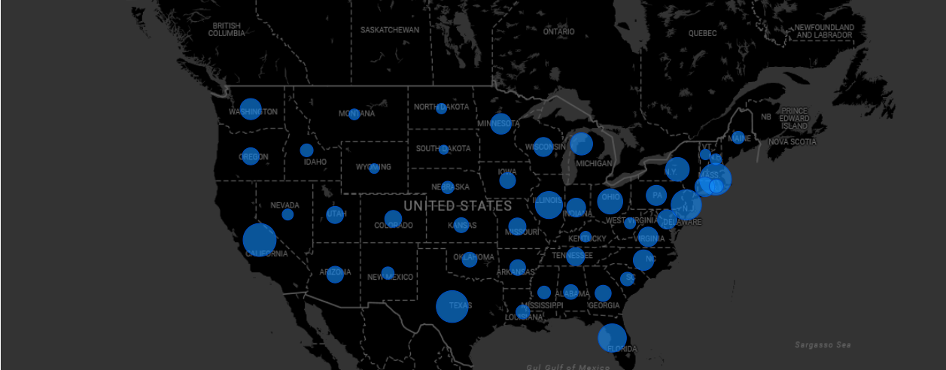
INSIGHTS AND ANALYSIS
At $15,98,65,086.8261096, California had the highest Total Revenue and was 2,514.50% higher than South Dakota, which had the lowest Total Revenue at $61,14,558.873195887.﻿﻿ ﻿﻿
California accounted for 7.72% of Total Revenue.﻿﻿ ﻿﻿ ﻿﻿Across all 47 state, Total Revenue ranged from $61,14,558.873195887 to $15,98,65,086.8261096.﻿﻿ ﻿﻿ ﻿

Slide 11
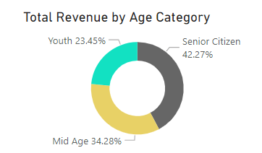
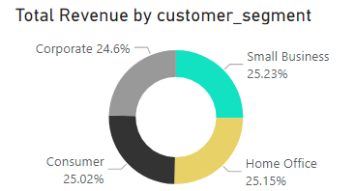
INSIGHTS AND ANALYSIS
Senior Citizen had the highest Total Revenue at $870M, followed by Mid Age at $710M and Youth at $480M.﻿﻿ ﻿﻿ ﻿﻿Senior Citizen accounted for 42.27% of Total Revenue.﻿﻿ ﻿﻿
﻿Small Business has the highest Total Revenue at $522.8M, followed by Home Office at $522.1M, Consumer at $518M and Corporate at $509M. Small Business accounted for 25.53% of Total Revenue
Notes:
$

Slide 12
CONCLUSION AND RECOMENDATION
Starting a marketing campaign in the regions like California, Florida, Massachusetts and New Jersey
Focusing on low sales region such as South Dakota, Rhode Island, North Dakota and Montana
Giving discounts and vouchers to Senior Citizens and Mid Age people who contributed to the overall sales

